Slide 1

Circles & Boxes
Drawing SecArch into your program while avoiding the Tyranny of the Ivory Tower

Slide 2
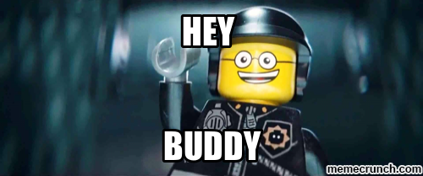
Introduction
Notes:
Good Morning Fellow Derbites
Thanks to David & the derbycon crew for this opportunity

Slide 3


How do you define a guy that doesn’t *DO* anything?
Christopher Robinson aka CRob
Sr. Program Manager for Product Security at Red Hat, Inc. (say that fast 5 times)
President of Cleveland (ISC)2 Chapter, CISSP Instructor, Children's Cyber Security Educator
18 years Enterprise Engineering/Operations Management and Strategic Planning experience
Worked for several Fortune 500 companies
Leader, artist, mentor, writer, strategerist, game-designer, brewer, Pirate, Dungeon Master, teacher, vintner, father, Buckeye, Cat-Herder, consultant, Boy Scout, teacher, Ambassador, gamer, Security-ologist, bacon-enthusist

Slide 4
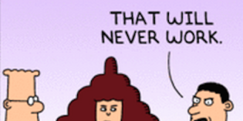
Abstract
Circles & Boxes – Drawing SecArch into Your Program – Chris Robinson
Circles and Boxes. Simple shapes on a page, yet such powerful tools to help describe complex problems. Security Architecture can be the tool in your arsenal that helps you tie together the trench warfare of blue team/ops with the esoteric Ivory tower world of Governance and Compliance. Come listen to a guy that doesn’t do anything tell you about how you can listen and learn to tie the frantic and often disconnected world of InfoSec together into a cohesive program.
Notes:
I'm excited to see so many other shape-enthusitists
I have a small disclaimer before we continue…..

Slide 5
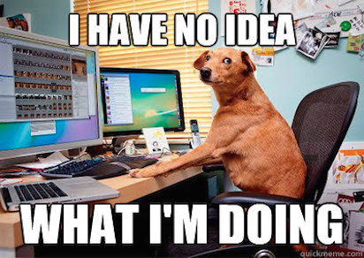
Disclaimer
Notes:
Don't let the lecturn here establish any heirarchy or power statement.
Today I'm going to share some pictures of cats and some insights I've gathered along my journey in InfoSec

Slide 6
Topics of Discussion
Circles!
Boxes!
Lines Connecting Circles and Boxes!
Lines Connecting Boxes to Circles!
Circles inside of Circles!
L33T P0W3RP01nt1NG! (ZOMG!)
Ivory Towers
Unicorns and Pirates
Security Architecture & InfoSec Programs
All told mostly in pictures
Mostly Images* source – images.google.,com

Slide 7
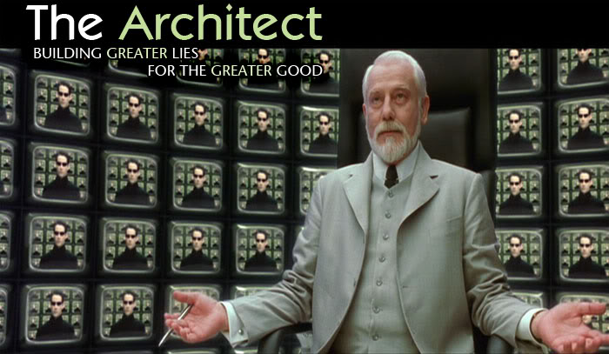
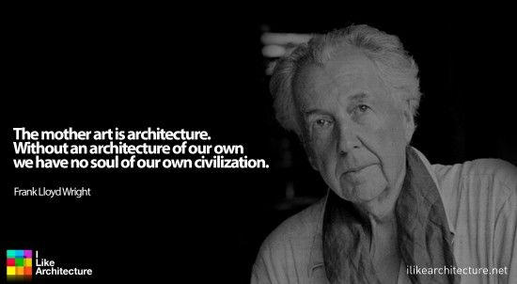
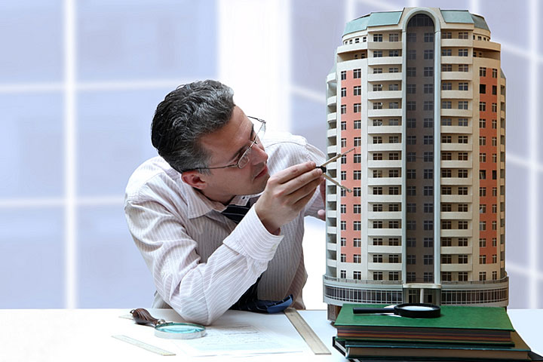
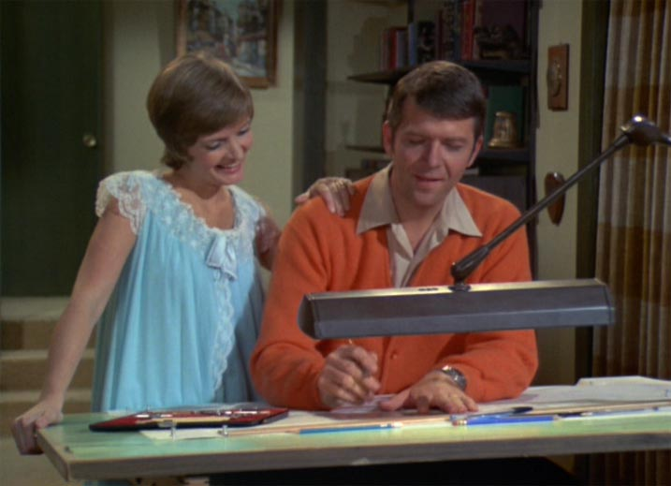
So, I’m an Architect…..
(please hold you boos, tomatoes, torches & pitchforks until the end of the presentation)

Slide 8
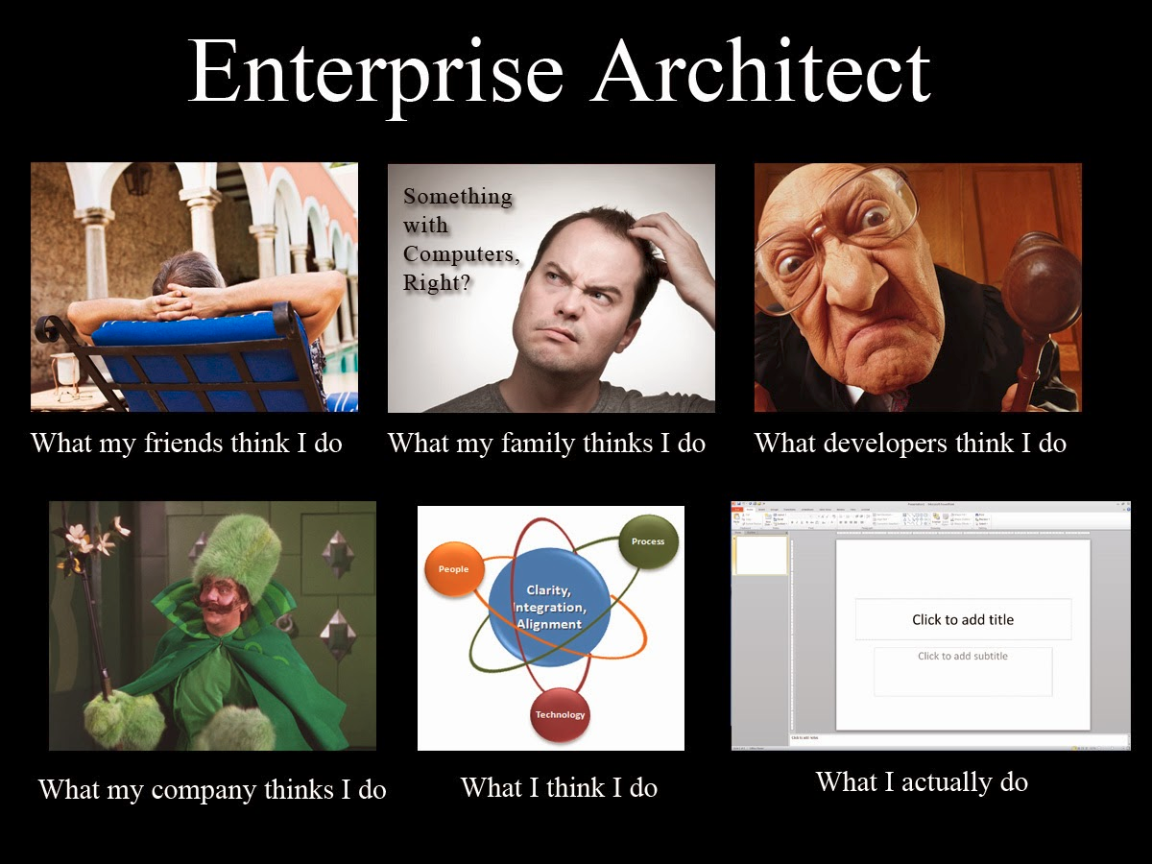
Notes:
Like most vocations, Architecture takes on many guises, performs many roles. I liken SecArch to be more like EA than SA, due to the broad focus normally required

Slide 9
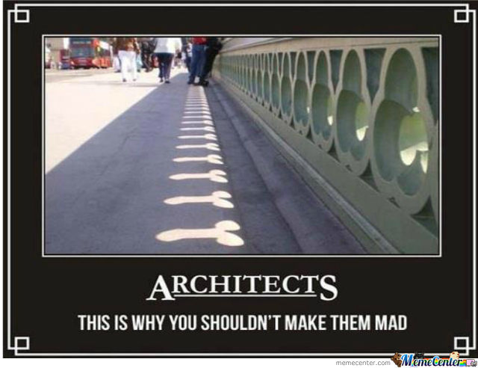

Slide 10
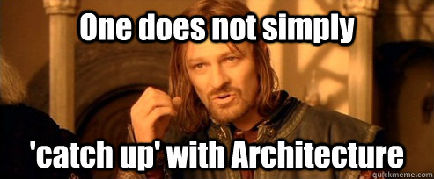
Our problem (or What do you do?)
We need to build quality and cost-efficient business solutions; That requires weaving complex packages into deliverables the organization can consume.
As complexity grows, using whiteboards and bar napkins quickly fails to be effective as engineering methods.
Ultimately we're trying to articulate complex business problems and provide technical or procedural solutions
Notes:
SecArch has a broad, Enterprise responsibiltiy
We must translate the needs of the business into actionable things and negotiate with the other organizational stakeholders within the context of the org's risk appetite

Slide 11
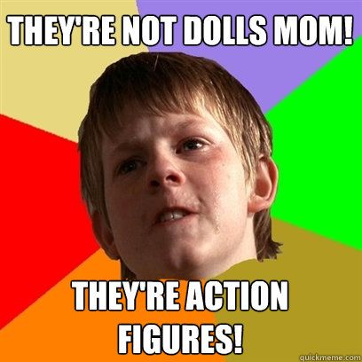
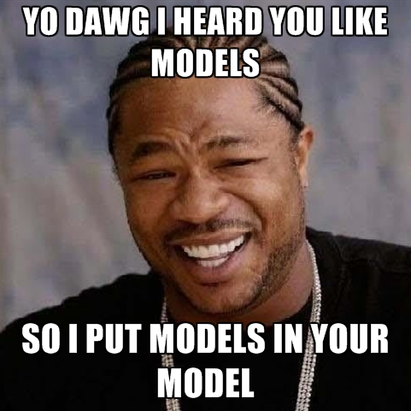
I play with models
Notes:
One method of this is through the use of abstracted models

Slide 12

Circles and Boxes
(...and Diamonds and Rectangles, Oh My!)

Slide 13
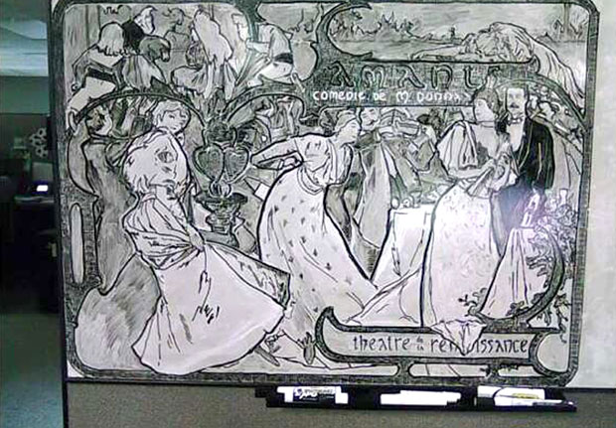
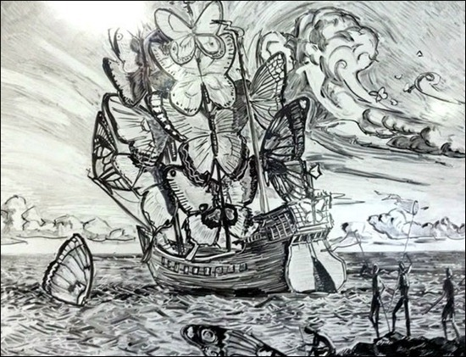
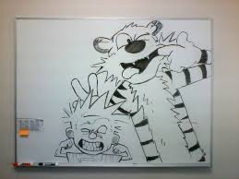
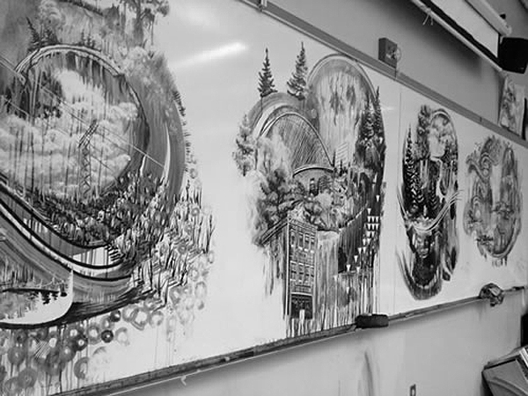
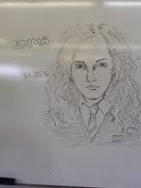
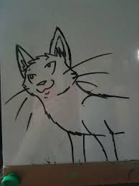
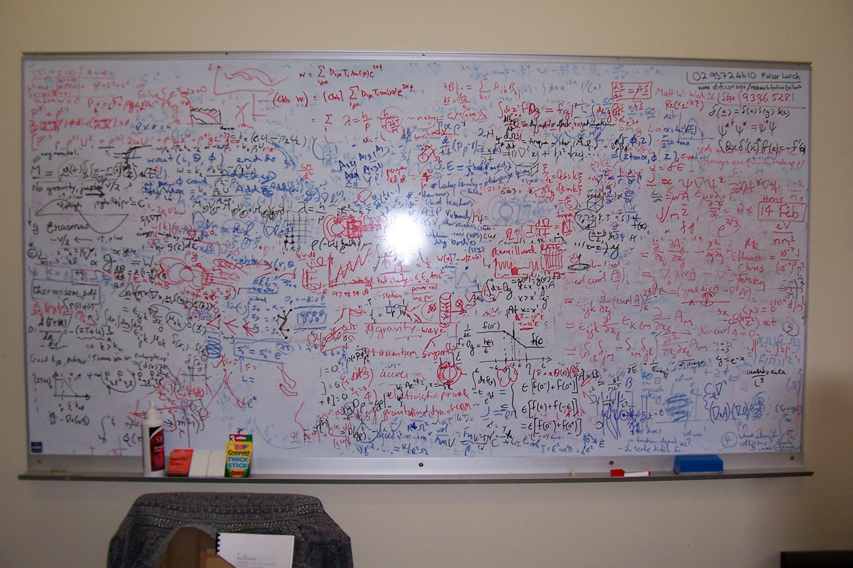
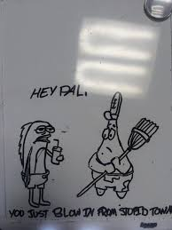
Whiteboard WAT – a brief tangent

Slide 14
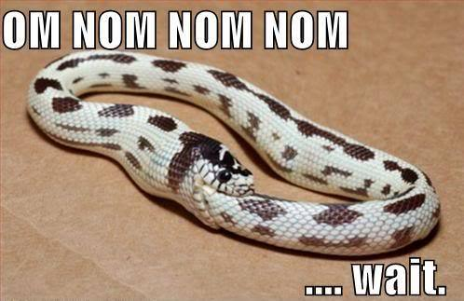
So……Circles
Notes:
So where was I? Oh yes….

Slide 15
Security Program Model
ZOMG! It’s full of SIRKURLZ!
Based on OESA – Open Enterprise Security Architecture – http://www.opengroup.org/subjectareas/security/architecture
Notes:
IINCEPTION!
We'll come to see why this structure is important as we roll along here
The constituents within JUST infosec

Slide 16
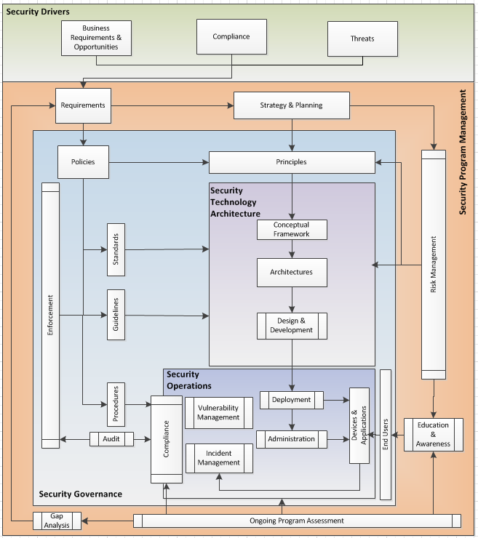
Boxes!
So many boxes….

Slide 17
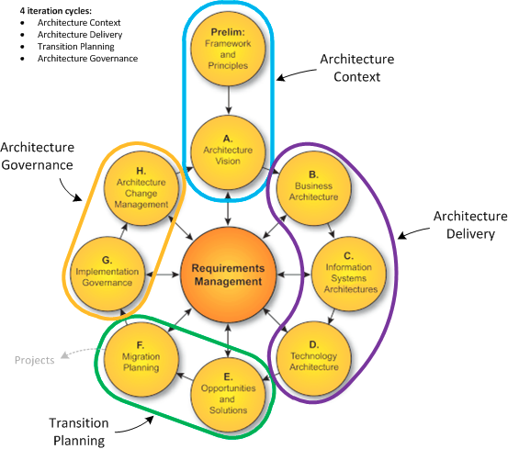
Me, I'm a TOGAF Guy
Circles going around in circles
http://www.opengroup.org/subjectareas/enterprise/togaf
Notes:
There are a lot of ways you can do this stuff
I'm trained in togaf, but I feel the best approach to “doing architecture” is a best of breed approach
I'm advocating a flexible approach, see what works and what doesn't in your org, and adjust along the way.

Slide 18
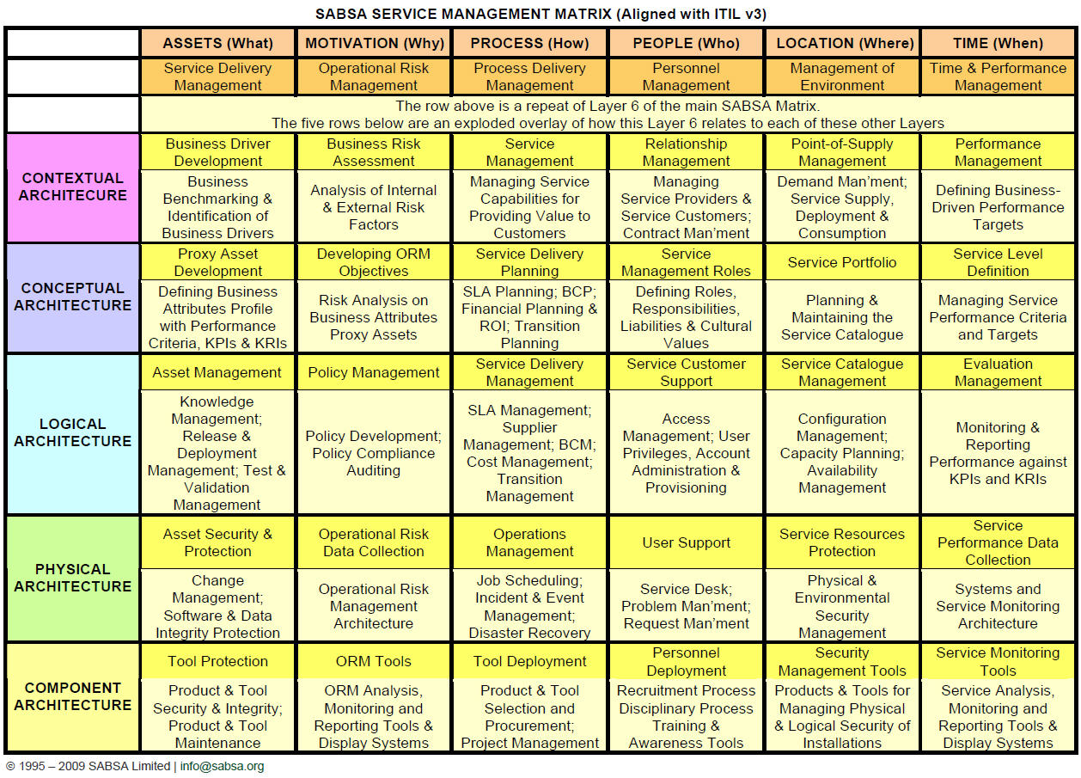
SABSA-cadabra!
Bring
me
more
Boxes!
http://www.sabsa.org/
https://en.wikipedia.org/wiki/Sherwood_Applied_Business_Security_Architecture
Notes:
SABSA is a cool security-focused method of thinking about things

Slide 19
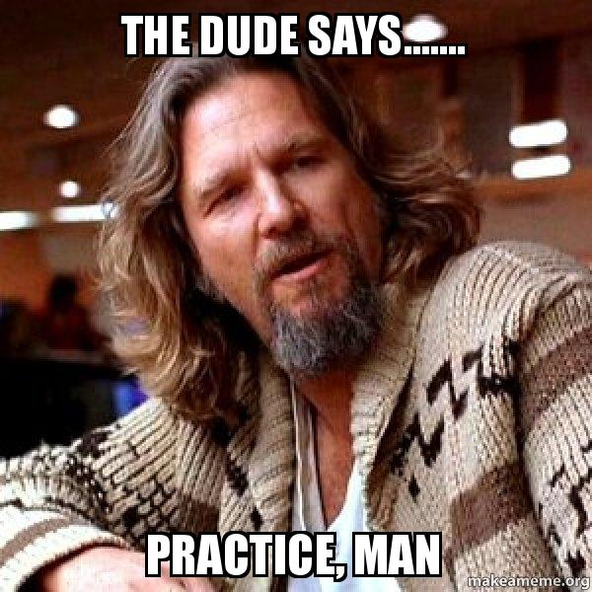
Notes:
Ok, ok, ok….so what?

Slide 20
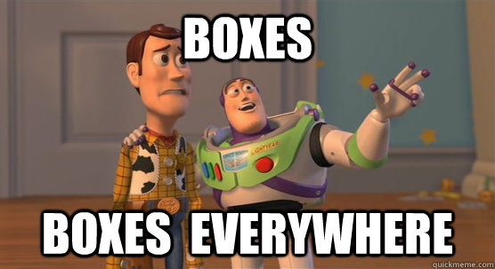
So A Real-World Example….

Slide 21
NIST Cybersecurity Framework (meh)
http://www.nist.gov/cyberframework/
Notes:
There are too many things to worry about with out having some kind of plan, some method of prioritizing things.
Without a strategy, your progam would be unfocused and you dillute your efforts chasing fires all day
Keep in mind, this is just ONE way you can approach the problem

Slide 22
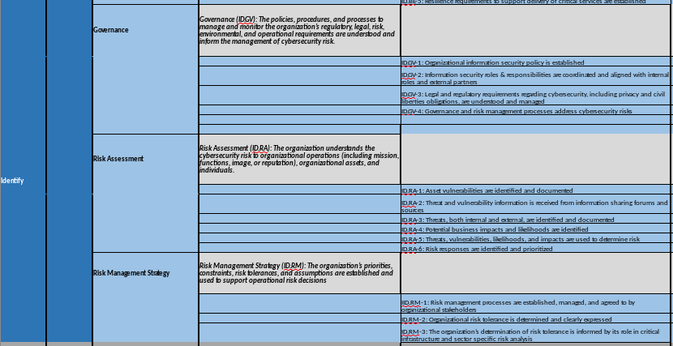
NIST Functions & Categories & SubCats

Slide 23


Slide 24
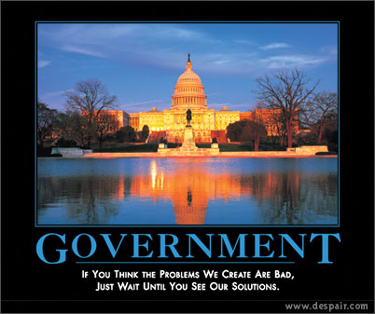
FFIEC Cyber Assessment

Slide 25
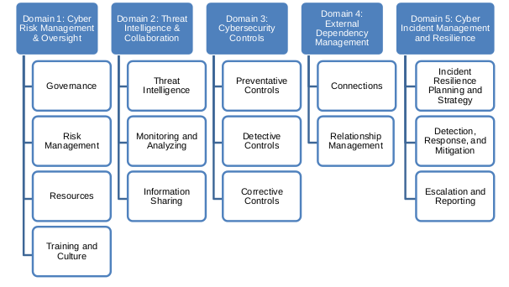
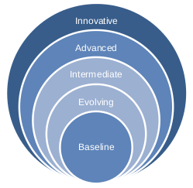
They're the Government, They Are Here to Help Us
What FFIEC Cares About
How They Want to Measure it
https://www.ffiec.gov/cyberassessmenttool.htm

Slide 26
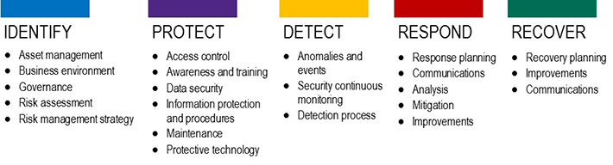

But NIST wants this….

Slide 27
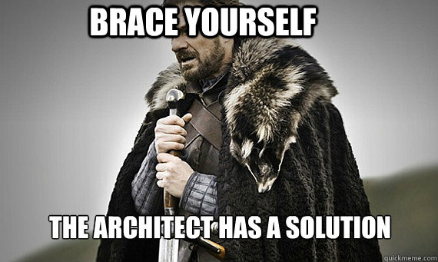

Slide 28
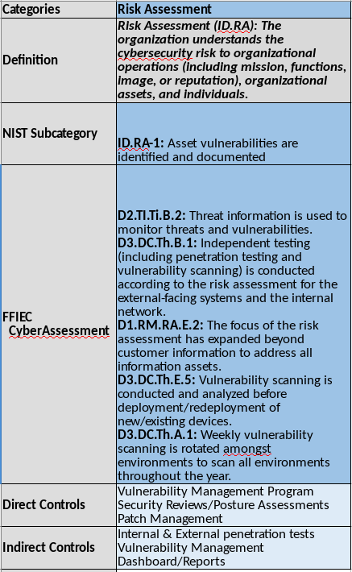

NIST-to-FFIEC-to-Controls Map

Slide 29
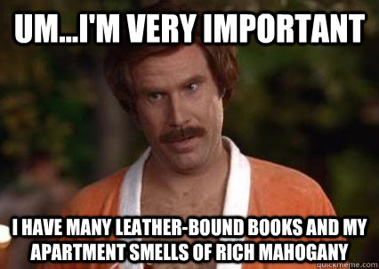
So Why is this important?

Slide 30


Slide 31
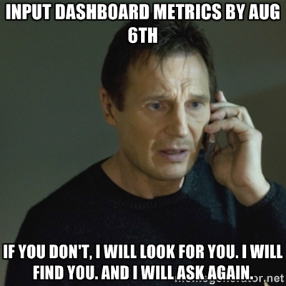
Metrics

Slide 32
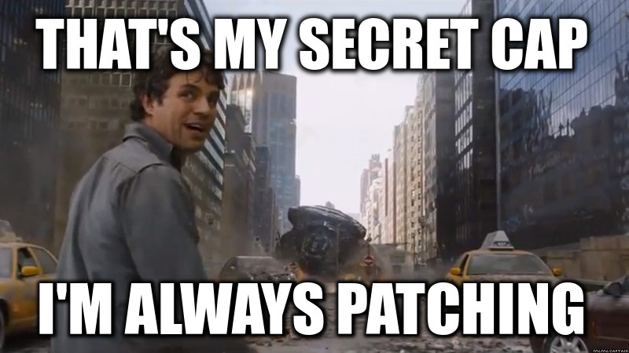
No, Seriously. Metrics
Let's take Vulnerability Management as an example:
Folks HAVE TO do it (this is where pentesters get a lot of mileage when folks aren't).
Everyone's got a Policy that says you should be doing it….
Most everyone's got tools to do it…
By applying some reasonable metrics you can measure how well (or poorly) that control is working.
And if it's not working, perhaps help highlight WHY it's not working & drive a better solution.
Notes:
EVERYONE has limited resources, time, and budget.
You will NEVER completely eliminate all of the risk your org faces
You have to be able to make risk-based decisions to apply those scarce resources
How do you know what's important if you can't describe or quantify it?

Slide 33
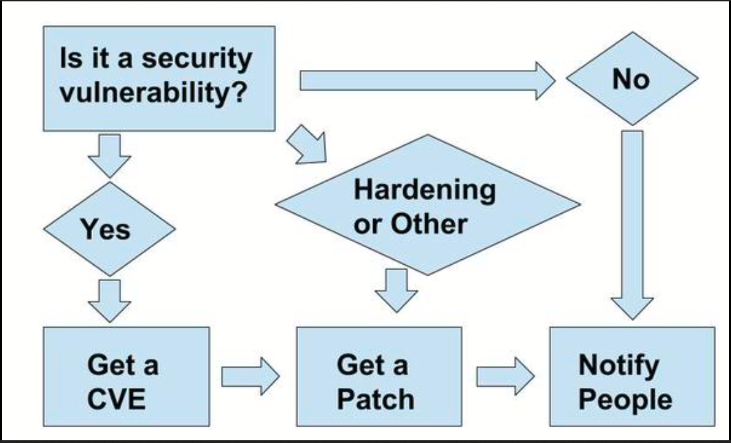
Tangent- A Simple Vulnerability Management Solution
Source – Kurt Seifried's Twitter - (kseifried++)

Slide 34
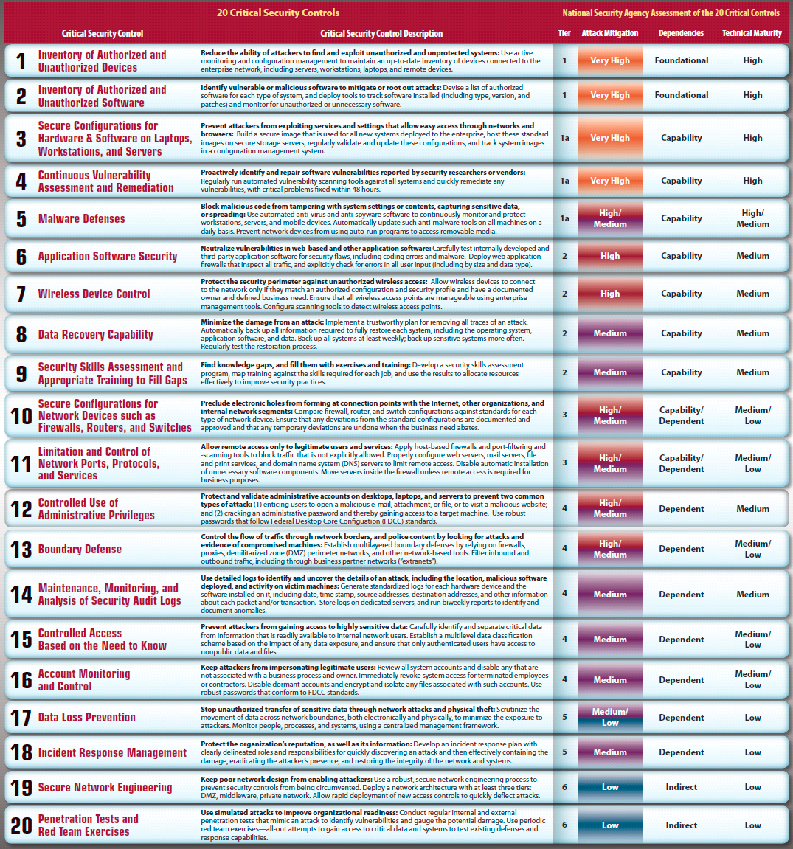
The SANS “Top 20”
https://www.sans.org/critical-security-controls/
Notes:
Depending on where you are in maturity and reasources, SANS is a great place to start out
Is it perfect? Nope, but it's a hell of a lot easier than reinventing the wheel

Slide 35
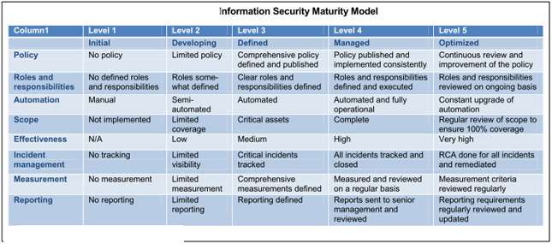
Leaders Like Maturity
https://en.wikipedia.org/wiki/Capability_Maturity_Model_Integration
http://www.isaca.org/Journal/archives/2008/Volume-2/Pages/Assessing-IT-Security-Governance-Through-a-Maturity-Model-and-the-Definition-of-a-Governance-Profile1.aspx
Notes:
So how do I know how I'm doing? Looking at Maturing is one lens to do that.
Think about where you are, where you want to be.
Rate those levels, look at the gaps...that is probably where you need to apply your time/dollars/people

Slide 36
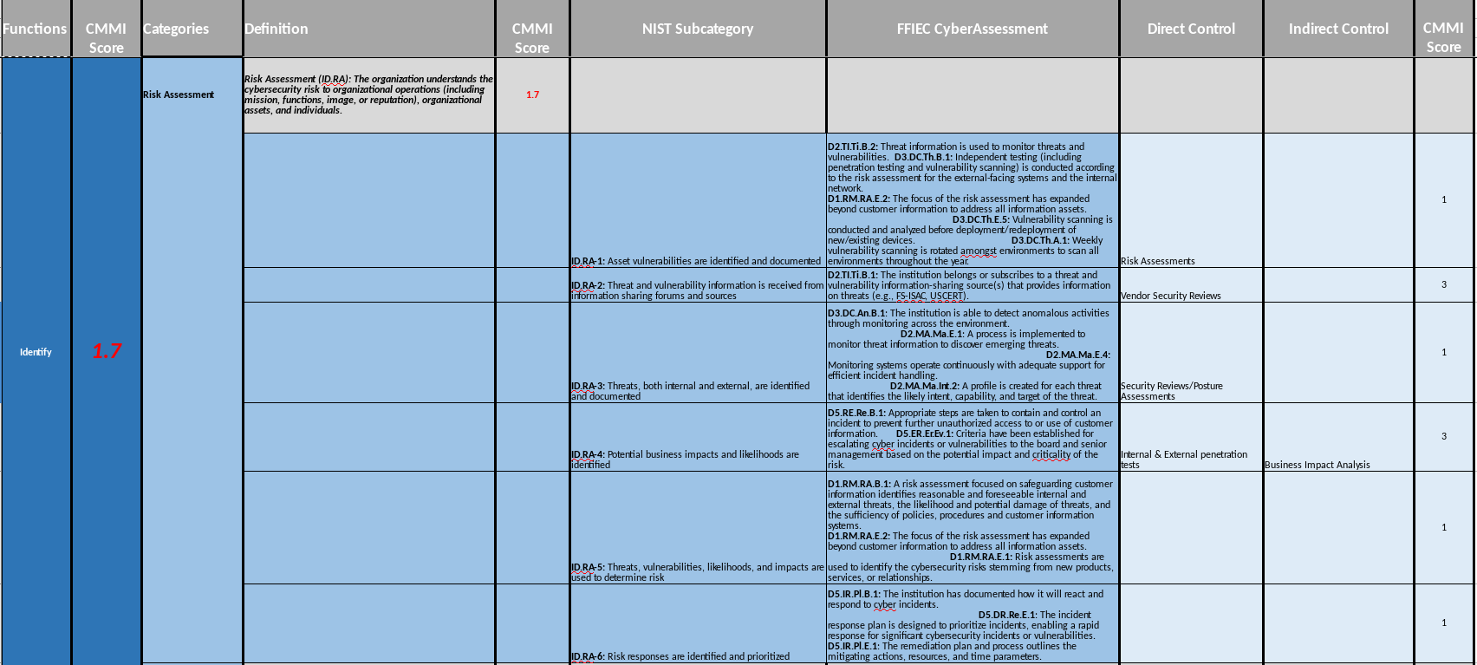
I Love it When a Plan Comes Together
Notes:
Some of these things you'll get automatic metrics on (# of tickets opened, did you hit your uptime SLAs, etc). Some you won't, so maturity is an easily understandable yardstick to help fill in those gaps where you might not have a computer counting things for you

Slide 37
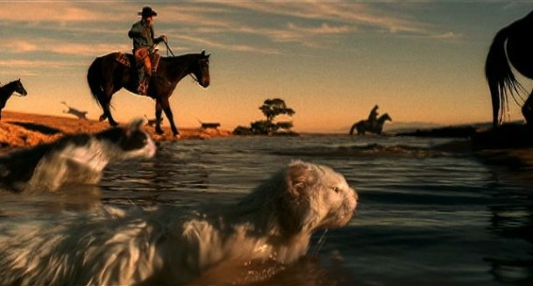
Enter the Cat Herder
Notes:
Role has not direct authority (normally. Your authority comes from your influence….who you know, how you conduct yourself, how persuasive are you?
Communication & documentation skills are critical

Slide 38
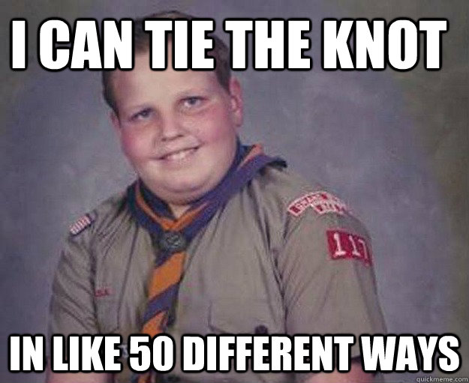
Tying It All Together

Slide 39

The Job of an Architect….
Notes:
Dream big

Slide 40
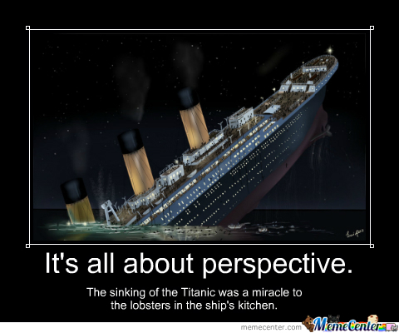
Notes:
Perspective is funny though, it all depends on which side of the table you're sitting at
Our mission, if we continue as a vocation, must be to drive perspective into the Legacy mindset that is pervasive in countless organizations

Slide 41
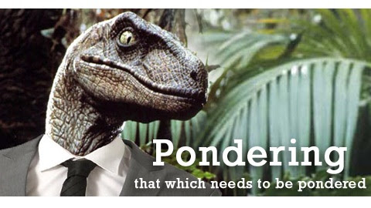

Slide 42

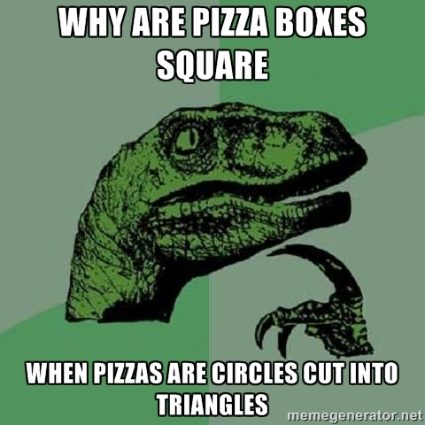
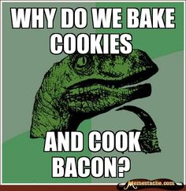
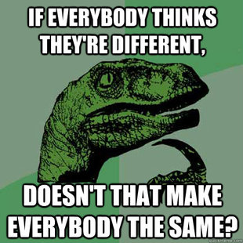
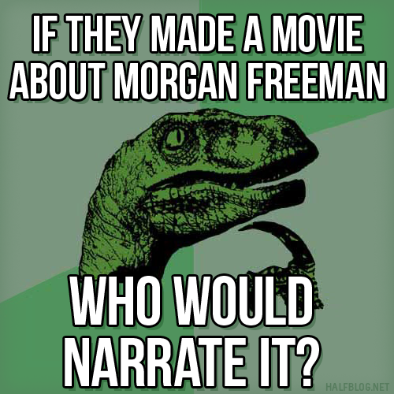
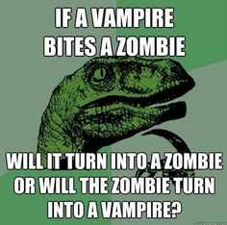
Architecture...Paid the “Big Bucks” to Think About Life's Big Problems…..
Notes:
Big ideas, big problems to solve
It's very easy to think everything can be “mathed” away or accurately described by an abstract model

Slide 43
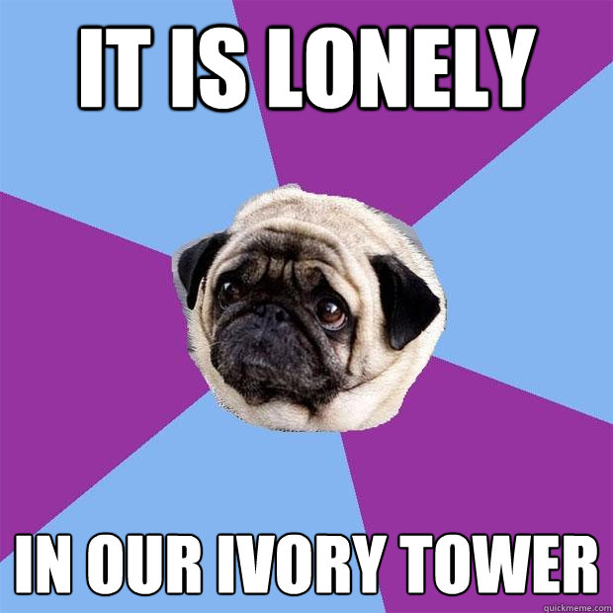
Notes:
When you're disconnected from things/people/processes, it's easy to lose sight of the real issues
With all these big thoughts floating around in your head, you may get disconnected from reality
No, really, China isn't coming after you, unless they are, in which case I'm sorry

Slide 44


Ivory Towers and Shiz
Oval, Circle's skinny brother
Notes:
Perfect is the enemy of good enough
Architecture can sometime trend towards a cultic state, it becomes self-serving and loses sight that we HAVE to add value to our customers and partners and HAVE to appropriately protect our customers' information

Slide 45


Slide 46

Notes:
The trap of the tower is you get stuck in the clouds, that you're not in touch with the real business problems your org faces.
You lack the context you need to be a true trusted advisor,

Slide 47

No Man is an Island
Circle!! ->
Notes:
Communitizing Tribal knowledge
Bridge those silo gaps
You can not do this alone
Great talk by Bill Sempf about sec & dev talking

Slide 48

There is no “u” in team

Slide 49


Notes:
So…..

Slide 50

It's a Journey, Not a Destination
Notes:
It is CRITICAL to get security baked into the process as early as possible.
(and if you don't have a process, you kinda should get some folks together and put one together

Slide 51

Boxes & Circles & Lines
Notes:
How the pieces of your secarch toolkit lay out and relate to each other

Slide 52

Final Thoughts
Don't let perfect stand in the way of good enough
Communitize Tribal Knowledge
Drive perspective in the organization to help overcome the “Legacy” mindset (“We've always done it this way.”)
Engage early, engage often
Build partnerships outside of your domain; find security advocates
Open-source your security
  -find your community, get peer feedback, share good practices, share intel,mentor others so we all can be successful.
<+++ HATE!!!!!!

Slide 53


Slide 54

It could happen, you know?
Apocalypse
Box
Notes:
Avoid this

Slide 55


In summary….
Notes:
Be your brand
Fight for what's right
Listen, work with others,

Slide 56


Questions?
Contact – CRob@RedHat.com
Tweets - @RedHatCRob
IRC - CRob

